Slide 1

Natural Language Processing PPT

Slide 2
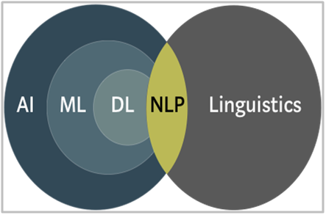
What is Natural Language Processing?
Natural Language Processing or NLP is the ability of machines to understand and analyze human language. It is a part of the Artificial Intelligence (AI) domain with a significant overlap with Linguistics.

Slide 3


Important libraries of NLP :
There are several important libraries in the field of Natural Language Processing (NLP) that provide tools and resources for processing and analyzing text data. Here are some of the key libraries frequently used in NLP:
NLTK (Natural Language Toolkit): NLTK is a widely-used library for NLP in Python. It provides various tools for tasks such as tokenization, stemming, lemmatization, part-of-speech tagging, parsing, and more. It also includes numerous datasets and resources for NLP research and experimentation.
SpaCy: SpaCy is a modern NLP library that is known for its speed and efficiency. It provides pre-trained models for various languages and supports tokenization, part-of-speech tagging, named entity recognition, dependency parsing, and more.

Slide 4
Feature Extraction :
Feature extraction means process of selecting and transforming raw data into a set of features that are more suitable for analysis or modeling.
Numerical Input: Machine learning models require numerical data, while text is inherently non-numeric. Feature extraction converts text into structured data that algorithms can process.
Pattern Recognition: Extracted features capture linguistic patterns and semantics, enabling models to understand relationships between words and make meaningful predictions or classifications.
In NLP, we do feature extraction mainly in two ways
1) Text Encoding
A) Count Vectorizer or Bag of words (BOW)
B) TF-IDF Vectorizer
2) Word Embeddings
A) Word2vec

Slide 5
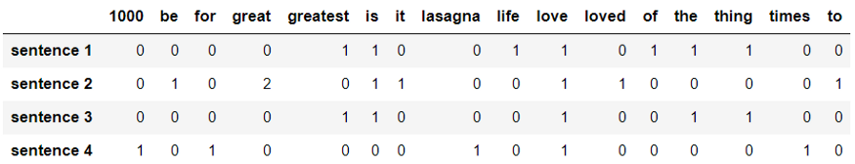
Count Vectorizer
It is used to transform a given text into a vector based on the frequency (count) of each word that occurs in the entire text.
corpus = ["The greatest thing of life is love.", "Love is great, it's great to be loved.", "Is love the greatest thing?", "I love lasagna for 1000 times"]

Slide 6
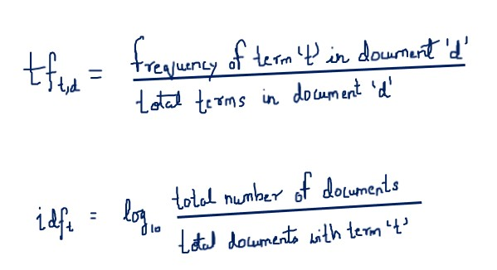
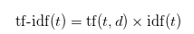
TF- IDF Vectorizer :
TF-IDF (Term Frequency-Inverse Document Frequency) is a text representation technique:
Term Relevance: TF-IDF combines term frequency (how often a word appears in a document) with inverse document frequency (how rare a word is across the corpus) to quantify the importance of a word in a document relative to the entire corpus.
Importance Weighting: IDF addresses common words' dominance by assigning higher weights to rare words, helping to emphasize distinctive terms that convey more meaning and reducing the impact of common stop words.

Slide 7
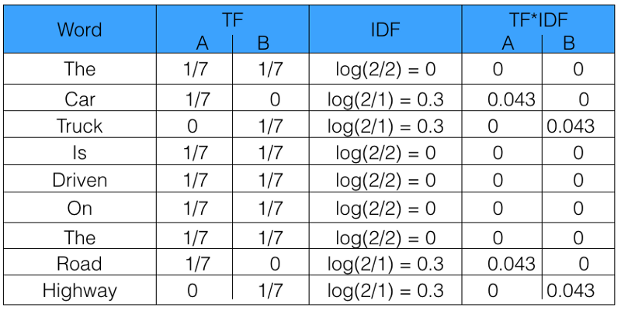
Let’s take an example to get a clearer understanding.
Sentence 1 : The car is driven on the road.
Sentence 2: The truck is driven on the highway.
In this example, each sentence is a separate document.
We will now calculate the TF-IDF for the above two documents, which represent our corpus.
From the above table, we can see that TF-IDF of common words was zero, which shows they are not significant. On the other hand, the TF-IDF of “car” , “truck”, “road”, and “highway” are non-zero. These words have more significance.

Slide 8
Disadvantages of Count vectorizer and TF-IDF :
Considers Only considers Frequency of words, Doesn't understand Meaning of Sentence.
Produces very big sparse matrix (lots of zero’s) if we have large amounts of data.
What we need feature extraction vector should be
Should be able to better understand the sematic meaning of sentences.
Should have fixed dense matrix even if we have large quantity of data

Slide 9
Word Embedding :
Word embeddings are a class of techniques where individual words are represented as real-valued vectors in a predefined vector space. Each word is mapped to one vector and the vector values are learned in a way that resembles a neural network.
Word embedding in NLP involves representing words as dense vectors:
Semantic Meaning: Word embeddings capture semantic relationships between words, enabling models to understand context and similarity.
Dimension Reduction: Embeddings reduce high-dimensional text data into lower dimensions, enhancing computational efficiency and reducing sparsity.
Improving Models: Word embeddings enhance NLP models by enabling them to learn and generalize linguistic patterns, leading to better performance in tasks like sentiment analysis, translation, and more.

Slide 10
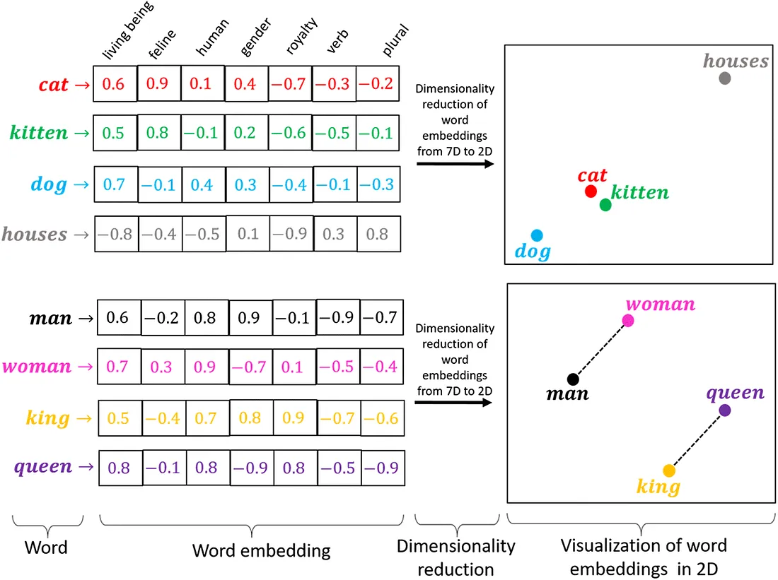

Slide 11
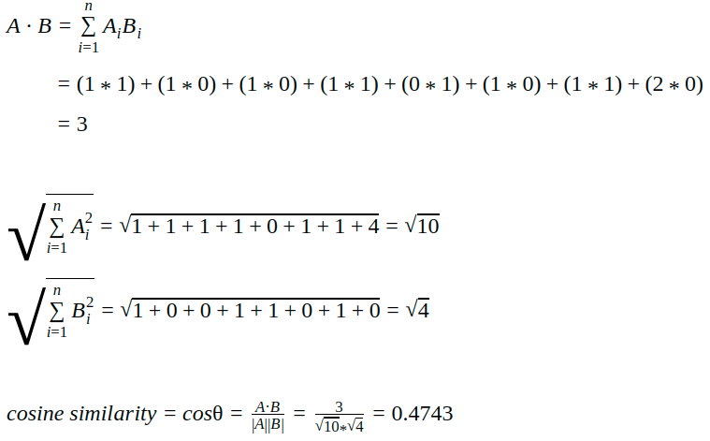
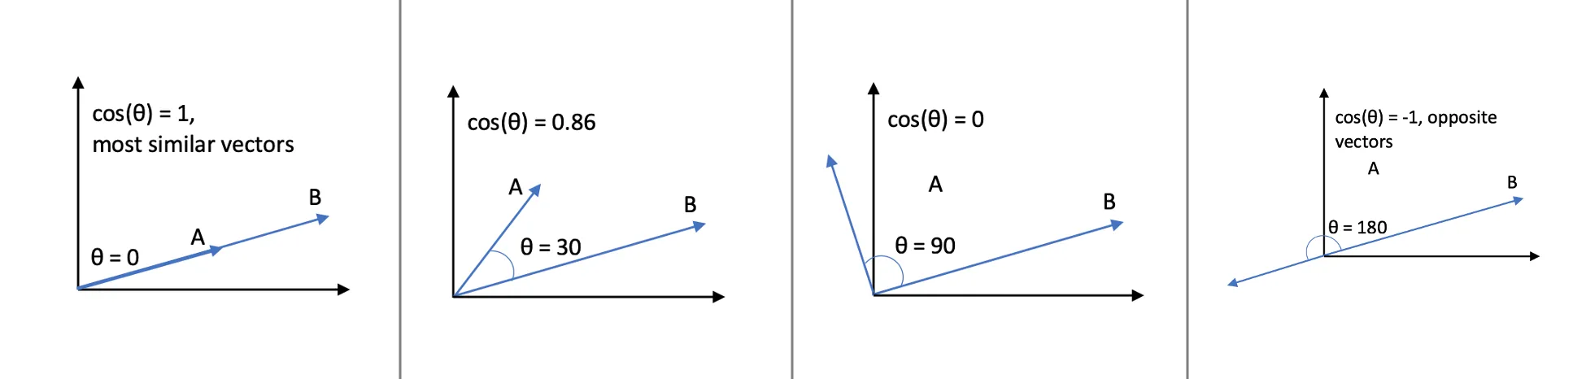
Cosine Similarity :
Cosine similarity measures the similarity between two vectors by calculating the cosine of the angle between the two vectors.
# Vector representation of the document doc_1_vector = [1, 1, 1, 1, 0, 1, 1, 2] doc_2_vector = [1, 0, 0, 1, 1, 0, 1, 0]

Slide 12

King: [0.5, -0.4, 0.7, 0.8, 0.9, -0.7, -0.6]
Queen: [0.8, -0.1, 0.8, -0.9, 0.8, -0.5, 0.9]
Man: [0.6, -0.2, 0.8, 0.9, -0.1, -0.9, -0.7]
Woman: [0.7, 0.3, 0.9, -0.7, 0.1, -0.5, -0.4]
Resulting Vector (King - Man + Woman): [0.6, -0.5, 0.8, 0.6, 1.1, -0.3, 0.5]
Cosine Similarity:
Cosine Similarity(King, Resulting Vector) ≈ 0.690
Cosine Similarity(Queen, Resulting Vector) ≈ 0.938
Cosine Similarity(Man, Resulting Vector) ≈ 0.628
Cosine Similarity(Woman, Resulting Vector) ≈ 0.632
These cosine similarity values indicate the degree of similarity between each vector and the resulting vector "King - Man + Woman". Among the given vectors, "Queen" has the highest cosine similarity with the resulting vector, suggesting that it is closest in semantic meaning to the condition "King - Man + Woman".

Slide 13
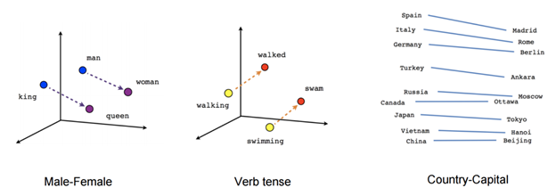
Word2vec
Vector Representation: Word2Vec represents words as dense vectors in a continuous space, capturing semantic relationships and similarities.
Contextual Learning: It learns by predicting a target word based on its neighboring words' context, either in a "Skip-gram" (predicting context from the target) or "CBOW" (predicting target from context) manner.
Semantic Proximity: Words with similar meanings have vectors closer together, enabling models to infer relationships and analogies (e.g., "king" - "man" + "woman" ≈ "queen").
Dimension Reduction: Word2Vec reduces high-dimensional word representations to lower dimensions, making computations more efficient and relationships more interpretable.
Pre-trained Models: Word2Vec models trained on massive text corpora can be used as pre-trained embeddings for downstream NLP tasks, saving training time.
Limitations: Word2Vec may struggle with capturing rare words or polysemous words (words with multiple meanings), and it doesn't consider word order beyond a certain context window.

Slide 14
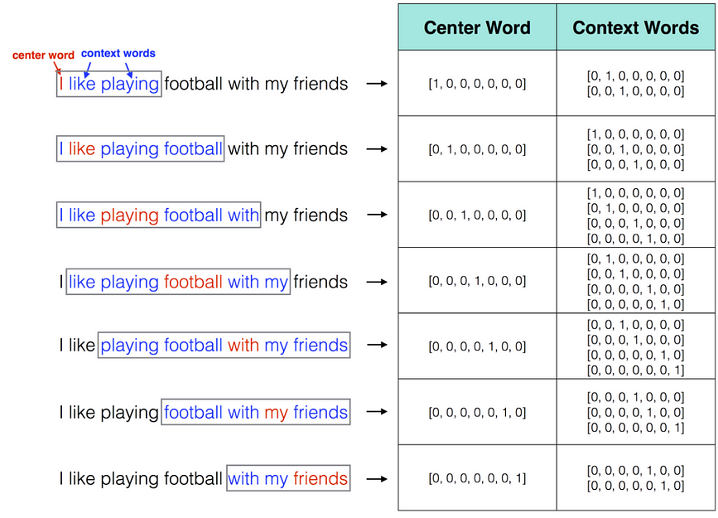
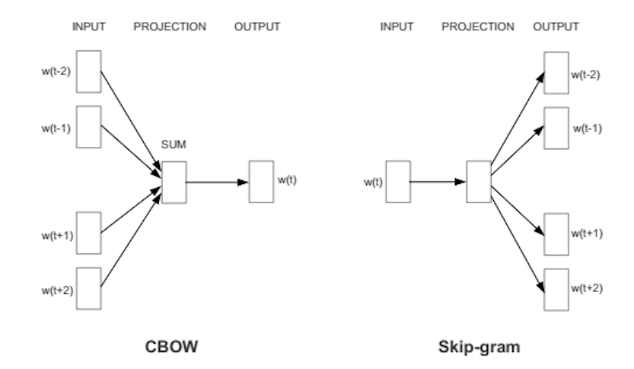
Word2vec

Slide 15
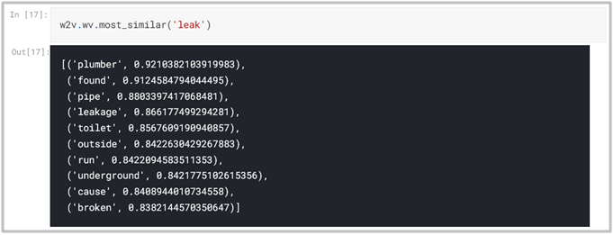
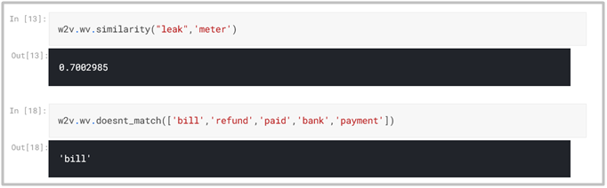
Some snippets of Word2Vec
In the first snippet, The model was able to predict similar words to leak such as plumber, broken etc. Which are related to leak.
In second snippet ,the model was able to find similarity between two words and was able to detect the odd one out in last line.

Slide 16
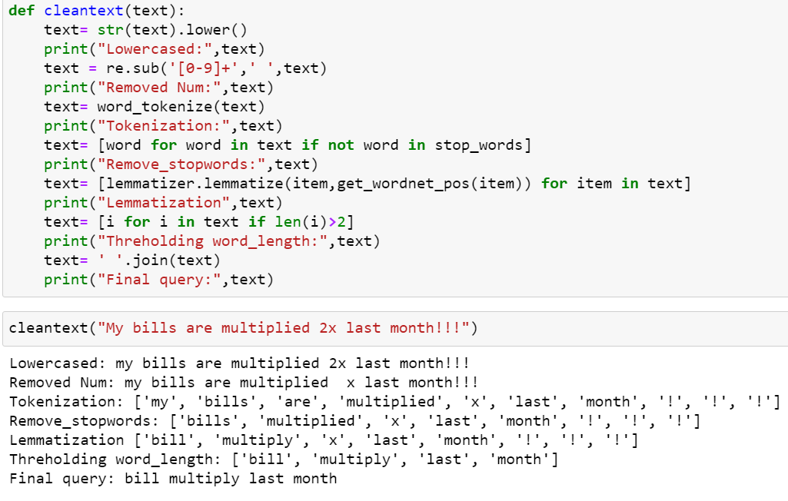
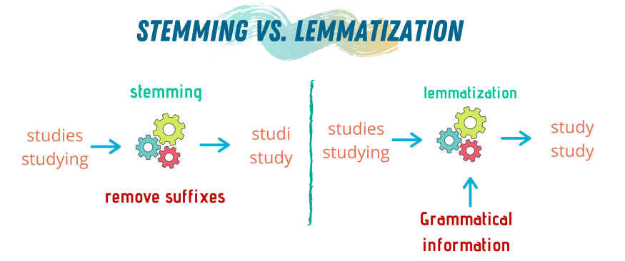
Text Preprocessing in NLP:

Slide 17
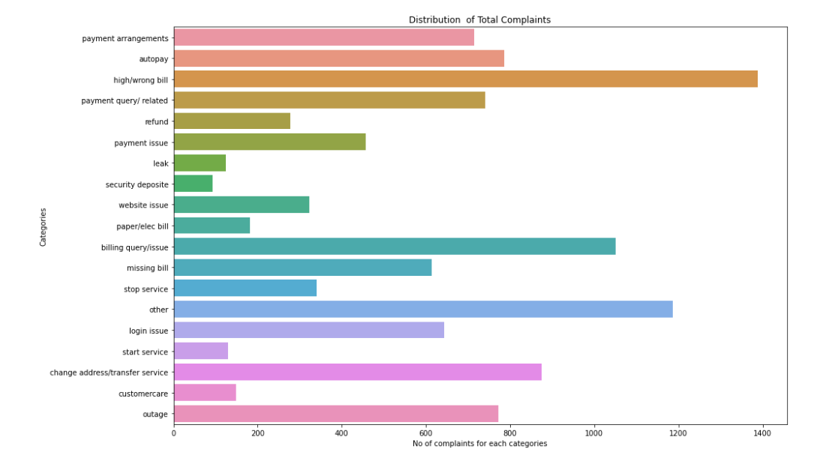
Data Visualization and Categories:

Slide 18
Current Models Limitation:
Models | Limitations
Count Vectorizer and TF-IDF | Considers Only considers Frequency of words, Doesn't understand Meaning of Sentence
Word2Vec | Can understand Meaning of Sentence but fails when creating embedding for Homophones For example, the word bank may mean ‘a riverbank’ or ‘Financial Banks’ But word2vec gives the same embedding for both the words
RNN,LSTM | Vanishing Gradient issue , Long range dependency issue,works for fixed
??? | Model which can take input and output of different sizes and better understand Meaning of sentences.
Notes:
Hi as vivek has explained about models .
Now I am going to discuss about models limitation

Slide 19
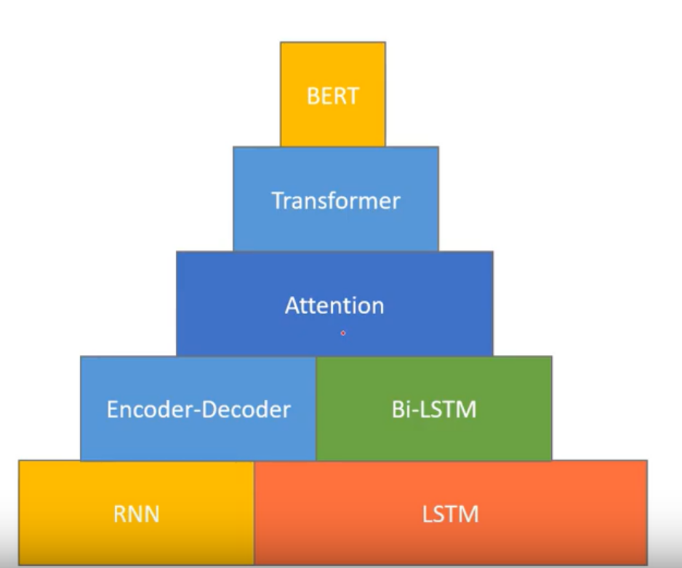
So, there required to build one model which can solve these problems
Vanishing Gradient
Can be used as a pre trained model for the downstream task while using transfer learning in NLP ?
Is bi-directional and understands the language form left to right and right to left ?
Understands deeper and better context of the language even if the longer input Sentences.
Deep Learning Techniques

Slide 20
Sequence to Sequence Model
Seq2seq is a family of machine learning approaches used for language processing. This model can be used as a solution to any sequence-based problem, especially ones where the inputs and outputs have different sizes and categories.
Example:
For Translating this Sentence “What are you doing today?” from English to Chinese has input of 5 words and output of 7 symbols (今天你在做什麼？). Clearly, we can’t use a regular LSTM/RNN network to map each word from the English sentence to the Chinese sentence.

Slide 21
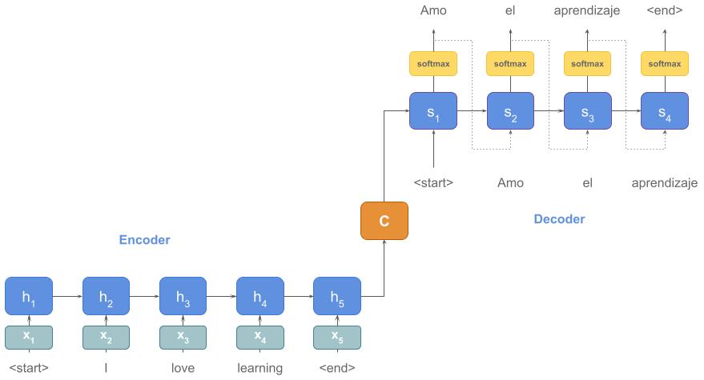
Encoder-Decoder sequence to sequence Model
The encoder LSTM/RNN is used to process the entire input sentence and encode it into a context vector, which is the last hidden state of the LSTM/RNN. This is expected to be a good summary of the input sentence. All the intermediate states of the encoder are ignored, and the final state id supposed to be the initial hidden state of the decoder
The decoder LSTM or RNN units produce the words in a sentence one after another
English to Spanish Translation
Notes:
Our first seq2seq model is encoder and decoder we have two parts one is encoder part and decoder part .For example purpose we have taken a sentence t"I love learning" to spanish.Firsst we take word embedding using ohotvector parallely and we can use any dp learning models like rnn,lstm,gru for encoding .waits for prev encoder hidden state .In final encoder we have context vector this contains entire information of input sentence and decoder uses it to decode the words

Slide 22
Disadvantage of Model:
The encoder creates a bad summary when it tries to understand longer sentences. It is called the long-range dependency problem of RNN/LSTMs.
The performance of the encoder-decoder network degrades rapidly as the length of the input sentence increases.
Notes:
Main disadvantage of models is
Does anyone have any questions on this?

Slide 23
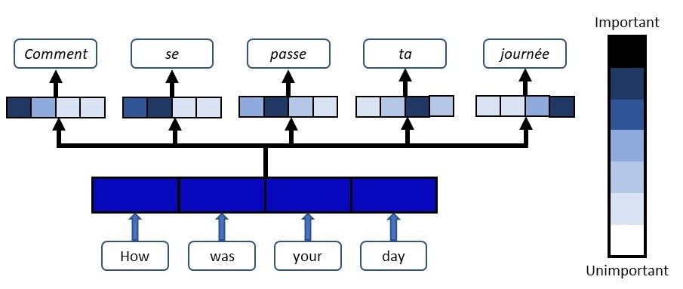
ATTENTION MODEL
A neural network is an effort to mimic human brain actions in a simplified manner. Attention Mechanism is also an attempt to implement the same action of selectively concentrating on important things, while ignoring others in deep neural networks.
So, whenever the model generates a sentence, it searches for a set of positions in the encoder hidden states where the most relevant information is available. This idea is called ‘Attention’.
English to French Translation
Notes:
Our next model is "Attention".wkt nn mimcs human brain function similarily attention mechanism focus on important things and neglects other things.
By this model can remember even for longer sentences

Slide 24


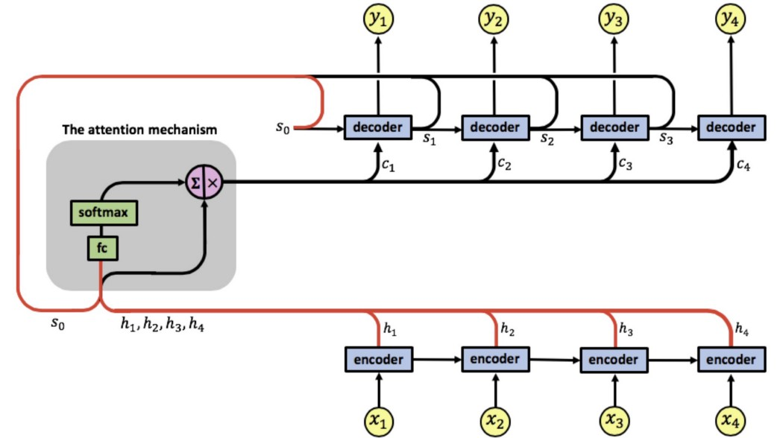
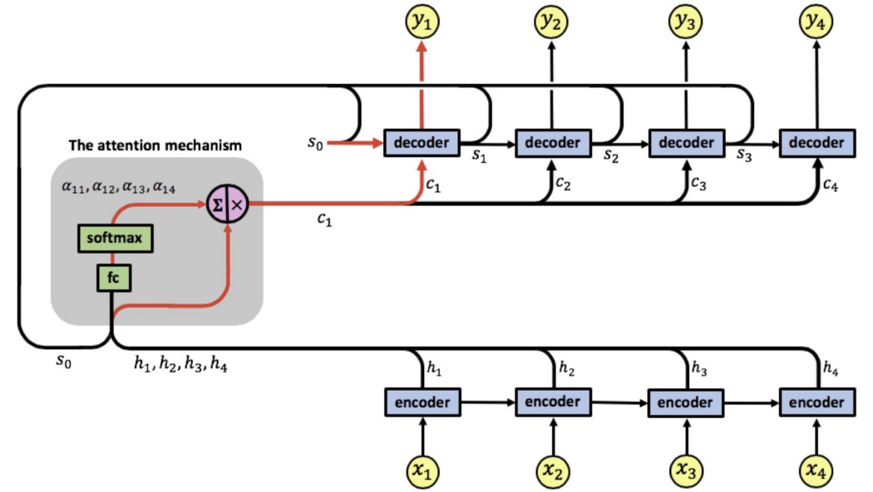
Working of Attention Mechanism
Step-1
Step-2
Notes:
Next we are trying understand working of attention mechaism .It's same as encoder & decoder.but we added an attention mechanism after encoder.
First attention mechanism takes initail stage of decoder <Start> tag and hidden states from encoder as input and calculates attention scores and as we seen in step 1 andNow based on attention weights and hidden states of encoder ,decoder tries to decode I/p sentence.
Does anyone have any questions on this?

Slide 25
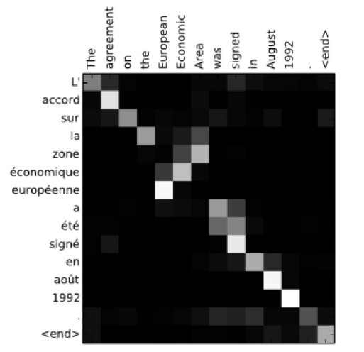
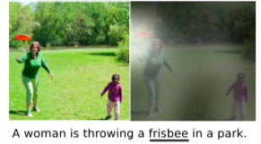
Attention Mechanism Examples
In Language Translation from English to French
In Image Caption Generation

Slide 26

Transformers :
The Transformer was proposed in the paper Attention Is All You Need.
The transformer is the first transduction model relying entirely on self-attention to compute the representations of its input and output without using RNN or CNN.
Encoder :
Takes input sequence and process it with self-Attention layers,
Decoders :
Takes Encoder output and sequentially outputs target sequence one token at time.
Ref: https://jalammar.github.io/illustrated-transformer/

Slide 27
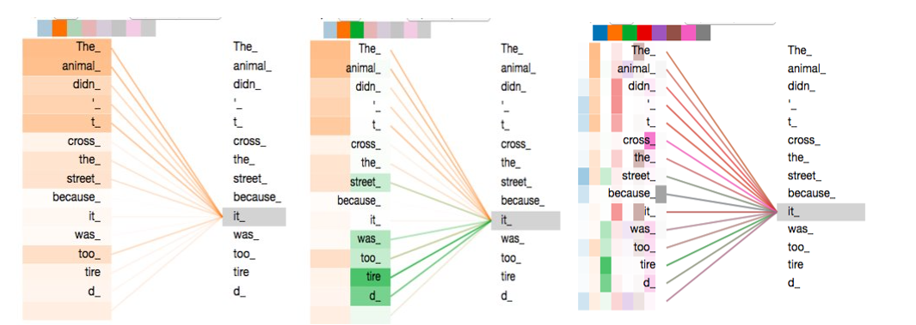
Important Modules of Transformers :
Self-Attention & Multiheaded Attention (Multi – parallel self-Attention) :
Parallelized Attention: Multi-head attention allows a model to focus on different parts of input simultaneously, capturing various aspects of context in parallel.
Feature Diversity: By projecting input into multiple subspaces, multi-head attention enables the model to learn different types of relationships and features, enhancing its ability to understand complex patterns.
Information Fusion: Through weighted combinations of attention results, multi-head attention combines context from different perspectives, enhancing the model's capacity to capture both local and global dependencies in the data.

Slide 28
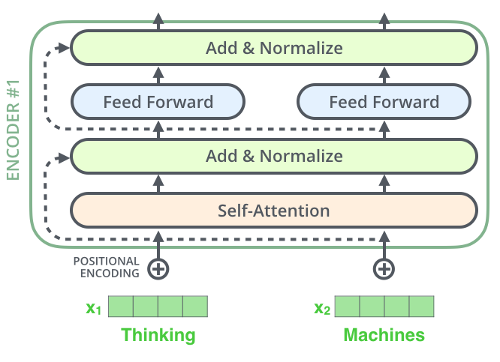
2) Feed-Forward Neural Networks (FFN): Enhances the model's capacity to capture complex patterns and interactions in the data after self-attention.
3) Positional Encoding: Provides information about word positions, aiding the model in understanding the sequential order of words.
4) Residual Connections and Layer Normalization: Crucial for stabilizing training and allowing gradients to flow effectively through deep layers.

Slide 29
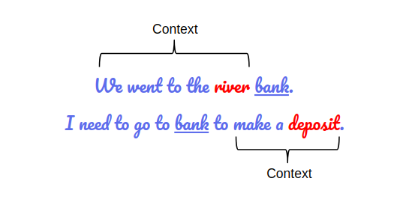
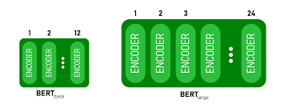
BERT
BERT which is Bidirectional Encoder Representations from Transformer. which is developed by Google in 2018 .
It is a powerful technique in understanding a language The BERT Model omits most the problems faced during the previous methods. It is designed to pre-train deep bidirectional representations from unlabeled text by jointly conditioning on both left and right context. As a result, the pre-trained BERT model can understand deeper and better context of the language even if the longer input Sentences.
It revolutionized the field of natural language processing (NLP) by achieving state-of-the-art performance on various NLP tasks, such as text classification, sentiment analysis, question-answering, and more.

Slide 30
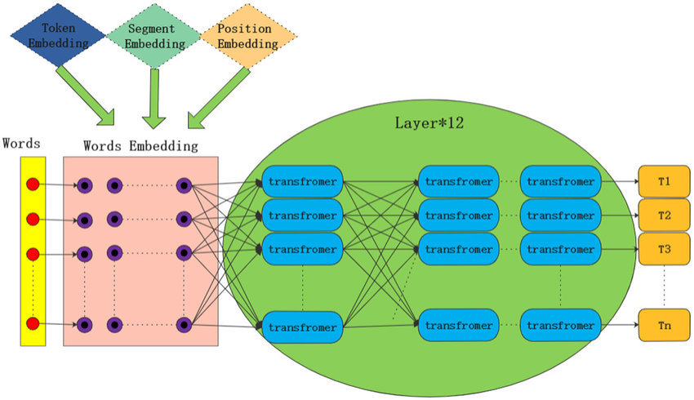
BERT Architecture

Slide 31
Pre-training: BERT is pre-trained on a large corpus of text using an unsupervised learning approach. During pre-training, it learns to predict missing words in a sentence by considering the context from both left and right sides of the target word. This "bidirectional" aspect is a key differentiator from previous language models.
Transformer Architecture: BERT is built upon the Transformer architecture, which is a deep neural network designed to handle sequential data like sentences or paragraphs efficiently. Transformers are known for their parallelization capabilities, making them suitable for large-scale language modeling.
Attention Mechanism: The Transformer's attention mechanism is the backbone of BERT's success. It allows the model to focus on relevant words in a sentence while processing information, giving it the ability to capture long-range dependencies and relationships between words effectively.
Embedding Layer: BERT converts each word into a high-dimensional vector representation called word embeddings. These embeddings preserve the semantic meaning of words and are used as input to the model.
Stacked Layers: BERT consists of multiple stacked transformer layers. Each layer refines the word embeddings through self-attention and feed-forward neural networks, enabling the model to capture complex patterns and dependencies in the data.
Masked Language Model (MLM): During pre-training, BERT uses a "masked language model" objective. It randomly masks some words in the input and tries to predict them based on the surrounding context. This forces the model to understand words in the context of the whole sentence.
Fine-Tuning: After pre-training, BERT can be fine-tuned on specific downstream tasks. This involves adding a task-specific layer on top of the pre-trained BERT model and training it on labeled data for tasks like sentiment analysis, named entity recognition, and more. Fine-tuning adapts the model to the specifics of the target task.

Slide 32
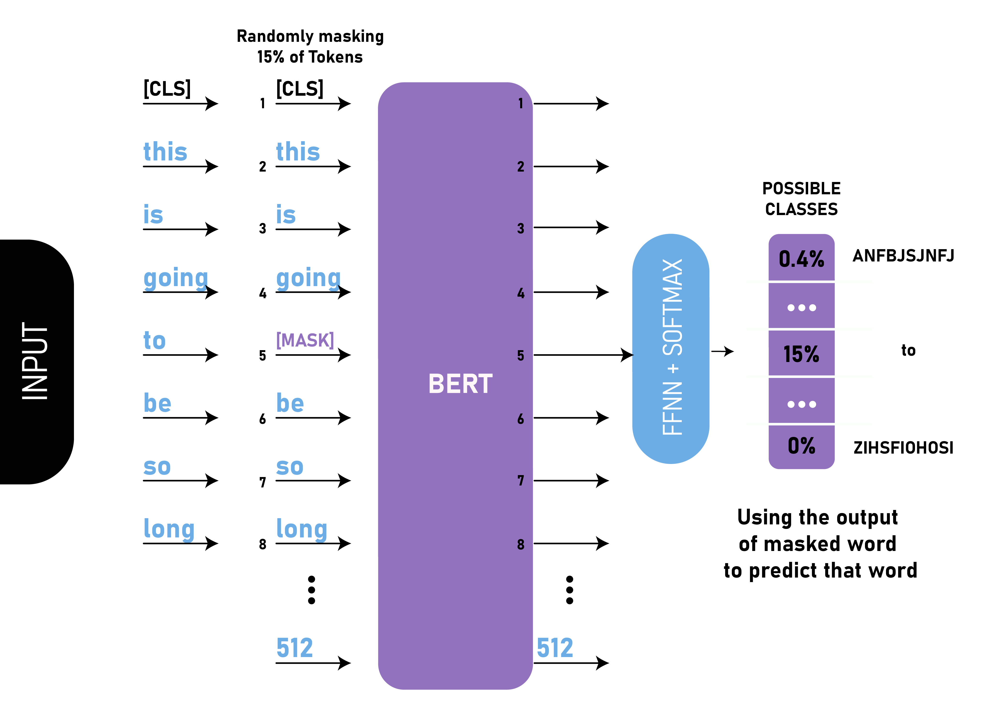
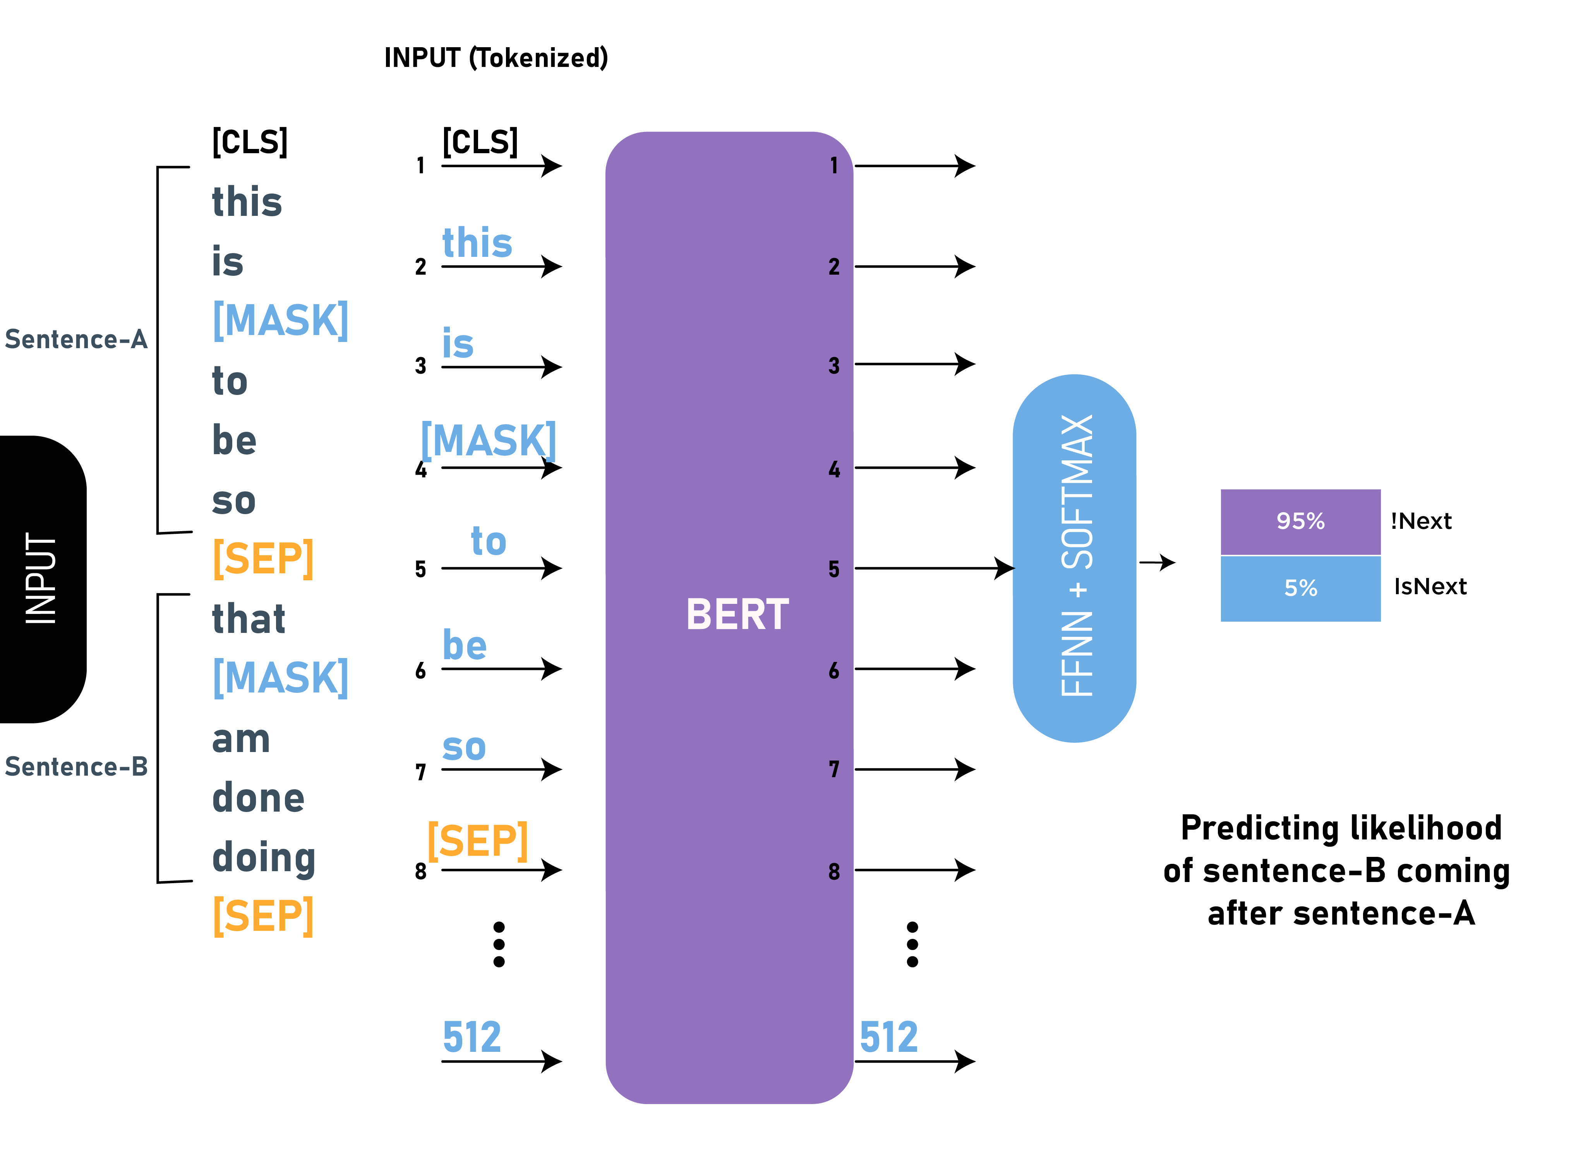
1.Masked Language Modeling
BERT uses two training strategies:
2.Next Sentence Prediction

Slide 33
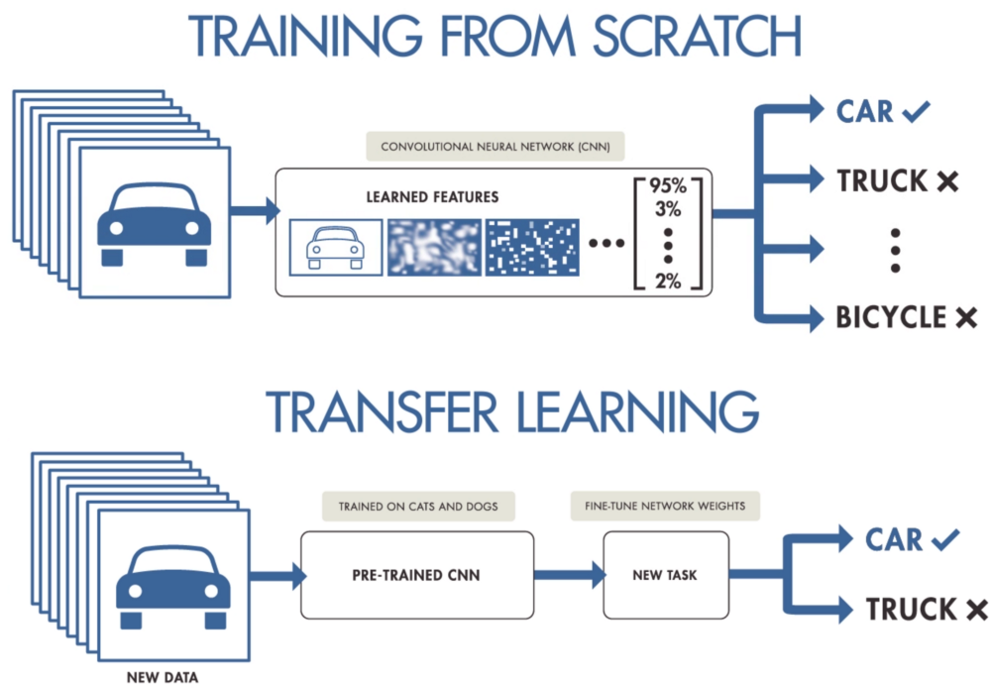
Transfer Learning – BERT MODEL

Slide 34
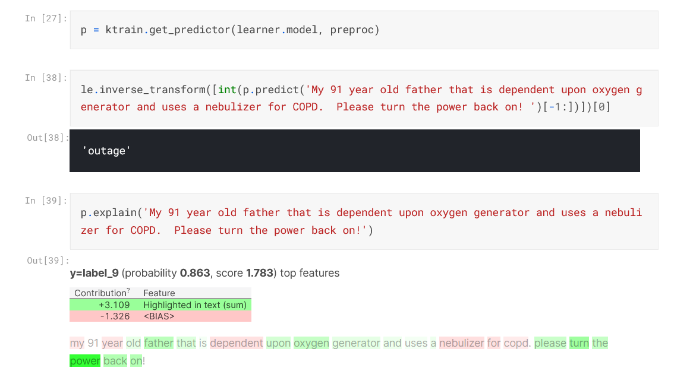
BERT Model as Text Classification Model:

Slide 35
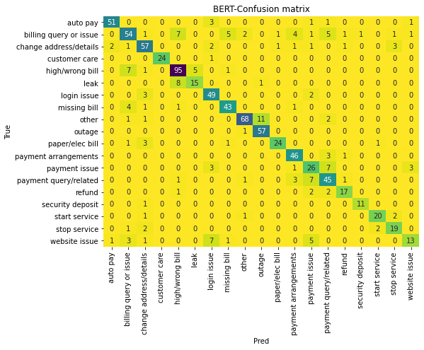
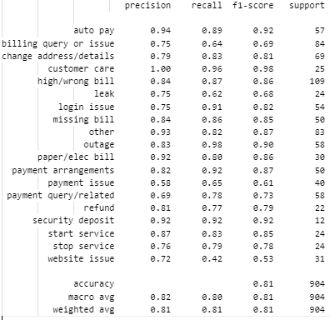
Results & Discussion:
Confusion Matrix for BERT Model
Classification Report for Bert Model

Slide 36
Challenges Faced
1. As the complaints are manually labelled. We observed lot of problems in dataset such as
Wrongly labelled data
Overlapping Categories
Imbalanced data for some categories
Lack of clarity for some complaints.
Which hampered the model's accuracy.

Slide 37

NLP CHATBOT (POC)

Slide 38
4) SEW NLP CHATBOT WORKFLOW :
Create ticket
Customer care
Workflow raises Tickets
( e.g., starting service)
Incorrect prediction
Message
from user
NLP classifier
(Main Category)
Intent validation by user
SUBCATEGORY IDENTIFICATION
Workflow requires data inspection
( e.g., checking high bill)
Category specific workflow
Correct
prediction
Model
improvement
SQUAD model
Return answer from context
Workflow answers general questions
( e.g., what's my acc no)
CHATBOT LINK : http://datascience.smartcmobile.com/NLPChatBot/

Slide 39
SQUAD - Question Answering 1. Stanford Question Answering Dataset (SQuAD) is a reading comprehension dataset, consisting of questions on a set of Wikipedia articles, where the answer to every question is a segment of text, or span, from the corresponding reading passage, or the question might be unanswerable. 2. It combines 100,000 questions with over 50,000 unanswerable questions written adversarial by crowd workers to look similar to answerable ones. To do well on Squad, systems must not only answer questions, when possible, but also determine when no answer is supported by the paragraph and abstain from answering. 3. On this dataset, pre-trained models are created which can be used on personal context and question pairs. We use these models to generate answers for the queries that the user may have by providing different utility-based paragraphs.

Slide 40
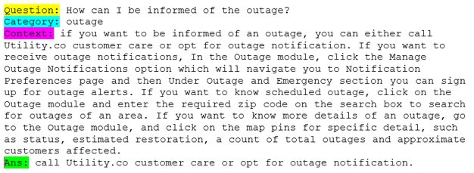
SQUAD A model trained on SQUAD data can read a passage of text and then answer questions about it.

Slide 41
Introduction – High Bill Analysis
In high bill analysis we are trying to validate complaints which are labelled as “ High-bill ” by our classification model based on usage data
To validate the complaints, we have to simultaneously match the period of complaint with the usage data of that account. By looking at their Value readings and calculating their usage score by looking at their historical pattern, we can define those complaints as valid.
For validating high bill complaints currently we are using
Usage data of 100 accounts for a period of 7 years.
Complaints data of these accounts for a period of 4 years.

Slide 42
Methods used
Currently we are trying to validate complaints using Z-score method in two ways:
Historical Usage Pattern:
In this method, we normalize the Usage values for each billing period of each account for every year. Then we try to find the change between z scores of an account with respect to previous years, we subtract the current z-score with z-score of previous years for same month, which results in Historical usage score difference. Based on this score, we generate a threshold to validate the complaint.

Slide 43
HISTORICAL USAGE PATTERN
 |  |  |  |  | threshold=0.25
AccountNumber | Value | Period | zscore | zscore_diff | valid
1313 | 312 | 201606 | 0.417479
1313 | 278 | 201706 | -0.19966 | -0.617139 | 0
1313 | 340 | 201806 | 0.925713 | 1.125373 | 1
1313 | 328 | 201906 | 0.707898 | -0.217815 | 0
1313 | 187 | 202006 | -1.85143 | -2.559328 | 0
mean | 289
standard deviation | 55.09265

Slide 44
2. Usage Comparison :
In this method, we normalize the values of each account for a single period by calculating their z-scores. In order to find the change between z-scores of an account, we take average of previous 3 z-scores and subtract the current z-score with this value, which results in their usage score. Based on this score, we generate a threshold to validate the complaint.

Slide 45
USAGE COMPARISON
 |  |  |  |  |  | Threshold=0.25
AccountNumber | Value | Period | zscorebyp | zscore_mean | score_avg_diff | Valid
6445 | 22 | 202008 | -0.1687 | -0.39577 | 0.227065 | 0
6445 | 30 | 202009 | -0.07777 | -0.31048 | 0.23271 | 0
6445 | 18 | 202010 | -0.35501 | -0.18927 | -0.16574 | 0
6445 | 23 | 202011 | -0.22552 | -0.20049 | -0.02502 | 0
6445 | 53 | 202012 | 1.318216 | -0.21943 | 1.53765 | 1
By using both Usage Comparison and Historical Usage Pattern we were able to validate high bill complaints

Slide 46
SEW NLP Products

Slide 47
SEW NLP Products
CHATBOT ANALYTICS DASHBOARD : OR NLP API's (LIVE)
INTENT ANALYSIS - BERT TEXT CLASSIFICATION MODEL
KEYWORD TRACKING - 1) BERT BASED WORD EMBEDDING, COSINE SIMILARITY 2) RULE BASED KEYWORD EXTRACTION - FUZZYWUZZY ,REGEX
WORD FREQUENCY - COUNT VECTORIZER
2) PROOF OF CONCEPTS :
SEW NLP CHATBOT - 1) BERT TEXT CLASSIFICATION MODEL 2) SQUAD MODEL 3) BERT WORD EMBEDDING, COSINE SIMILARITY 4) DATABASE 5) STATISTCS RULES
NLP AUTOLABELER - 1) BERT TEXT CLASSIFICATION MODEL 2) FAST CLUSTERING METHOD 3) POS TAGGER

Slide 48
NiSource Deployment

Slide 49
NiSource Data consists of: 1. Account EmailMessage 2. User Behaviors 3. Conversational History We use Conversational History Data which contains of chat between user 1(CUSTOMER) and user 2(BOT). By using these data we tried to apply different analysis such as word-frequencies and tried to classify Messages by user 1 into pre-defined Categories by using Bert and analyzed these data using Data Visualizations.
Introduction

Slide 50
Word Frequency
To generate Word Frequencies and Word Clouds, we use only the messages by user 1 to observe the most frequent words in each period(202108,202109 and 202110) present in the data.
Messages by user1 contains of pre-defined options selected by the user and their personal queries.
We then use Count Vectorizer to generate most common unigrams, bigrams and trigrams in the messages.
In order to know the topic trends in each period, we have generated Word Clouds for each period and for the whole dataset as well using these n-grams.

Slide 51
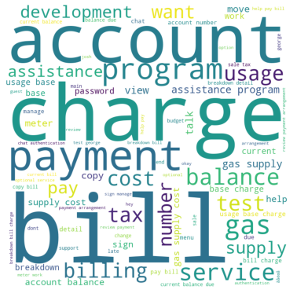
Whole Dataset 5 most common n-grams: 1. Bill 2. Charge 3. Account 4. Payment 5. Service

Slide 52
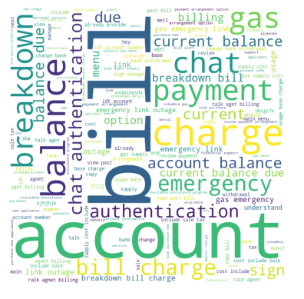
Period 202108 5 most common n-grams: 1. Account Balance 2. Chat Authentication 3. Breakdown Bill 4. Usage 5. Outage example of message: I need to know breakdown of my billing charges.

Slide 53
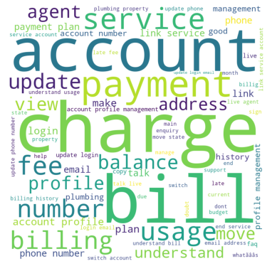
Period 202109 5 most common n-grams: 1. Account Profile 2. Payment Plan 3. Link Service 4. Understand Usage 5. Account Profile Management example of message: I want to understand my usage consumption.

Slide 54
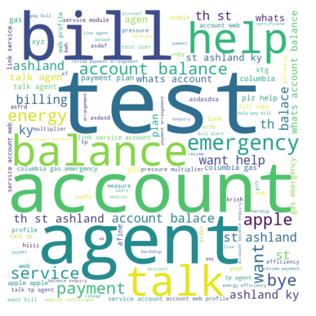
Period 202110 5 most common n-grams: 1. Account Balance 2. Payment Plan 3. Link Service 4. Web Profile 5. Gas Emergency example of message: I want to link my service account to my web profile.

Slide 55
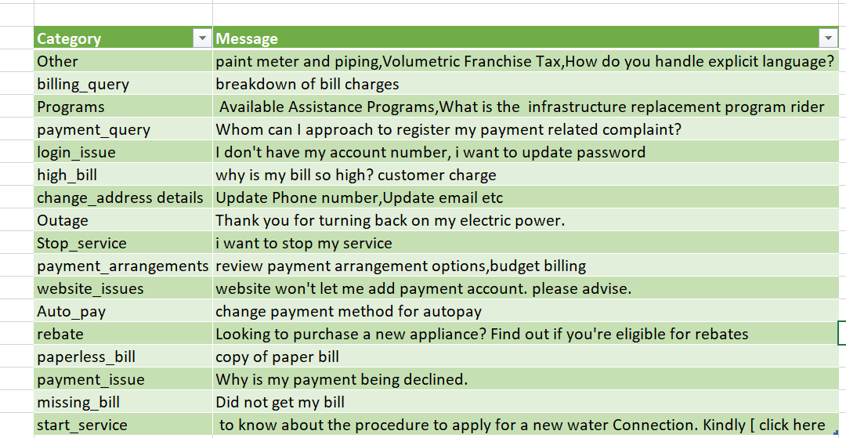
Classification of Queries Using Pretrained Bert Model
To Classify into respective categories, we have used our pretrained-Bert Model to user1 Messages for the period(202107,202108 and 202109) present in the data after removing
pre-defined options selected by the user .Some examples for each category from Ni-Source data

Slide 56
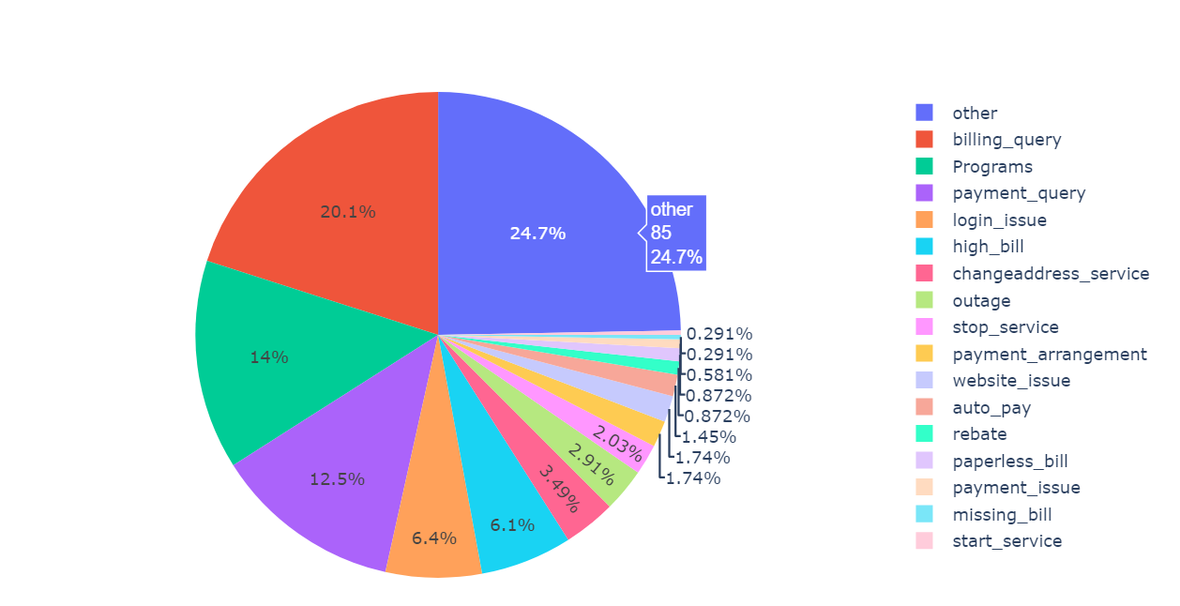
Data Distribution Using Pie chart

Slide 57
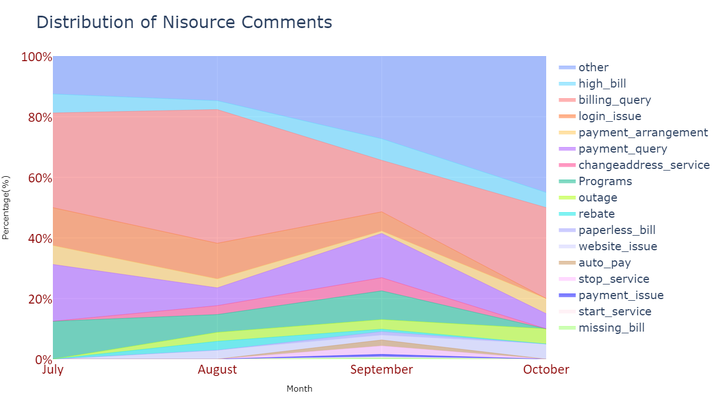
Data Distribution Using Stacked percentage area graph

Slide 58
Other Analysis NiSource

Slide 59
Problem statement
We have observed lots of messages are getting predicted as other category by the classifier model for the Ni-Source data.
So, we analyzed this messages for better understanding the other's category and produced solutions for reducing the others category.

Slide 60
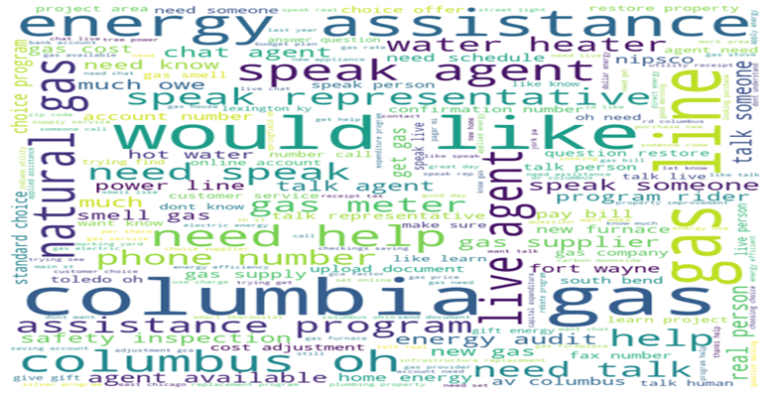
Exploring the other category
We have extracted around 89,500 messages from Ni-source database. Out of this these around 43582 messages were predicted as other category.
Majority of the messages (35062) in the other category are user information like name, account number, phone number, email etc. (Noise messages)
After removing Noise messages, we are left with
8520 messages. By word frequencies we found some topics.
The topics covered in these messages are
Special programs
Asking for human representative
Queries regarding gas

Slide 61
Noise data
Noise data is junk data which contains unnecessary information like greetings, names, address, account number, phone number, emails which is a part of chatbot workflow. Our previous model is predicting this noise data as others. We are using some filtering methods like regex expression, based on word lengths to filter out some of this data.
Noise Data Type | Message
Greetings | Ok thank you, thanks for your help, Goodbye, You too.....Bye!, please
Names | Tara, Rick Scott, Wanda, Robert may
Address | 5429 ASPEN, PORTAGE, IN, 46368 , 550 woodland road Mansfield, Ohio
Account No, phone number | 757-546-4274, 17575464274, 5408090788, ****58830010007, account 10807630010006 on Eddy spark Drive
others | paul@creager.org, 1Ismail1Imani2021@gmail.com, por favor solo hablo espaÃ±ol (Other Lang)

Slide 62
New categories from Data Labelling
Category | Message
Assistance Program | Can you help me with assistance program
 | how do I sign up for NIPSCO New Energy Assistance Programs for Seniors and Veterans?
 | I was approved for energy assistance, and I keep getting notices that it's been applied to my account, but the balance is not reflecting that.
Customer choice program | Can you tell me how long I have had DTE Gas Supply as my supplier
 | How did Snyder Bros. Energy Marketing become my gas provider when I thought it was Columbia Gas?
 | who is my current gas supplier
Gas line related | Can nipsco run a gas line from my house to the garage
 | I want to enroll in insurance for gas line
 | Someone is marking my yard for electric and telephone lines saying they are replacing a natural gas line. I know nothing about this!
Rebate | Where do I find rebates that Nipsco offers?
 | I just got a new heater central air and water heater installed now do I find out if I qualify for rebates

Slide 63
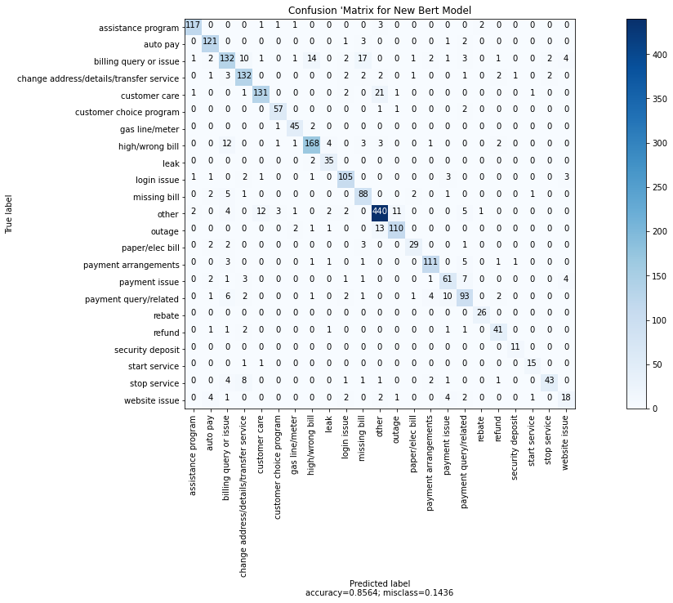
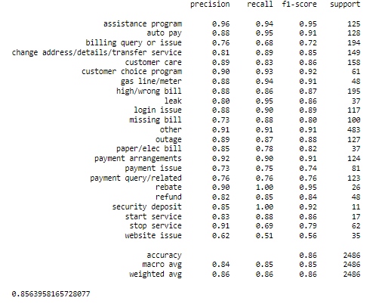
NEW BERT Model
We train Bert model on latest categories and was able to achieve 85% accuracy for test data

Slide 64
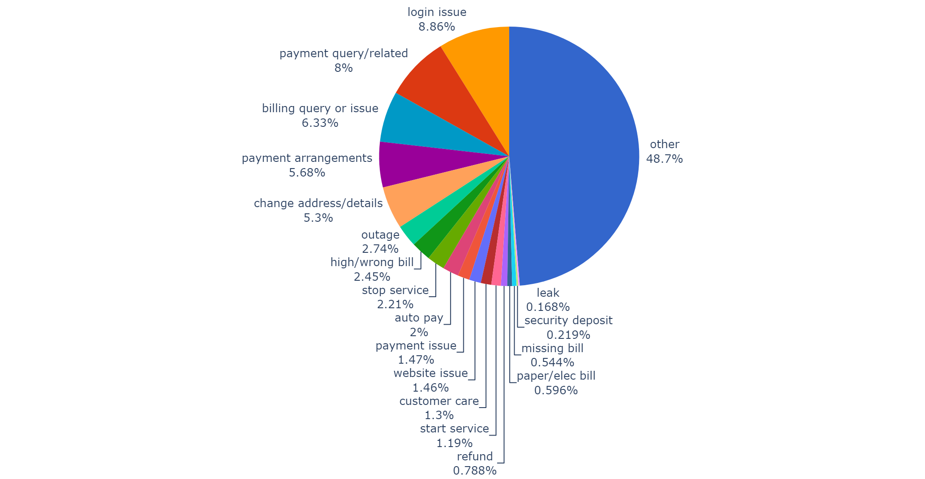
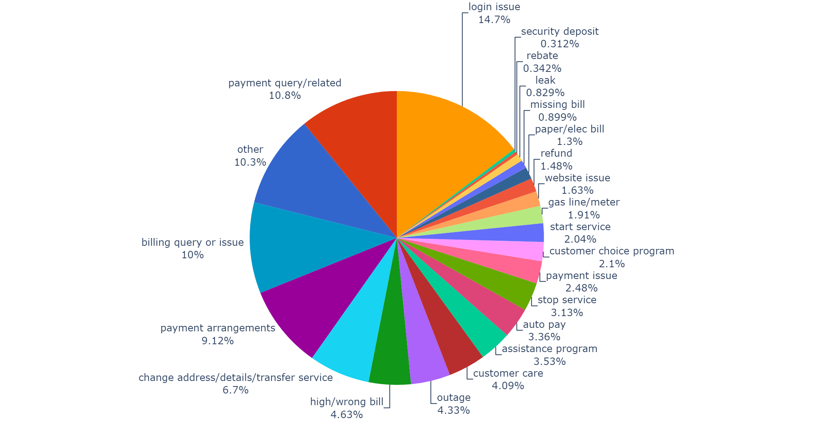
Data Visualization before and after performing Other Analysis

Slide 65
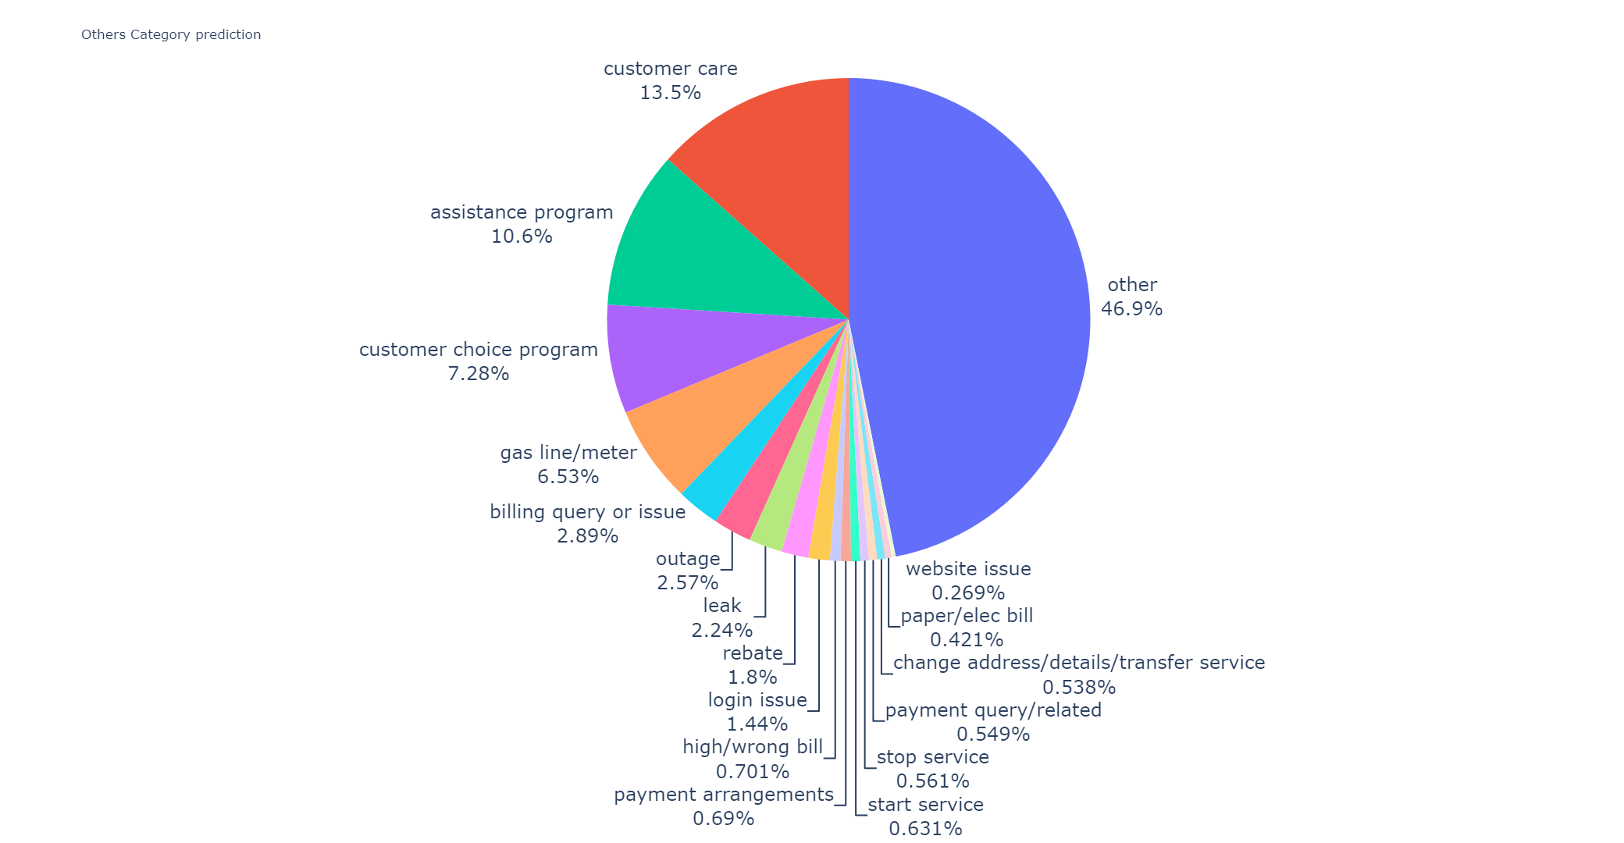
Other's Category Distribution

Slide 66
NLP self-training
We have manually labeled 12 K data
Labelling the data is time consuming since it requires human resource
We have a lot of unlabeled data that can be used to improve the accuracy of the model
Useful for new client labelling as new types of queries can be found.

Slide 67
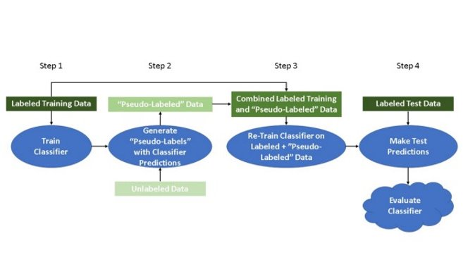
Self-Training:
In self training we have some labeled data and unlabeled data. We use the labeled data to label the unlabeled data.

Slide 68
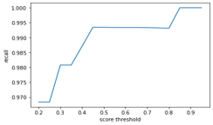



Examples of different categories
Autopay
High Bill
Missing Bill
Login issue

Slide 69
Table showing the percentage of data we can label correctly for different categories:
Category​ | Percentage (%)​
auto pay​ | 89.090909​
high/wrong bill​ | 59.440559​
leak​ | 95.000000​
security deposit​ | 94.736842​
paper/elec bill​ | 34.285714​
missing bill​ | 37.398374​
customer care​ | 51.724138​
login issue​ | 61.068702​
change adress/details/transfer service​ | 68.361582​
refund​ | 37.500000​
payment issue​ | 50.515464​
outage​ | 98.717949​
stop service​ | 60.000000​
other​ | 64.467005​

Slide 70

Current issues:
There are some classes for which we don’t have enough data.
We don’t get good recall for these classes, so we are not able to label enough data for these classes.
Possible solution:
Data Augmentation:
We translate the text message to a random language.
Then we translate it back to English.
We get a new sentence with the same meaning but written in a different way.
Below is an example.

